Slide 1
Agile for Model-Based Standards Development
Brandon Sapp
Melissa Harvey
Sylvere Krima
Marion Toussaint

Slide 2
Presentation Overview
Statement of Business Need
Problem Statement
Proposed Solutions
Benefits/Impacts
Next Steps

Slide 3
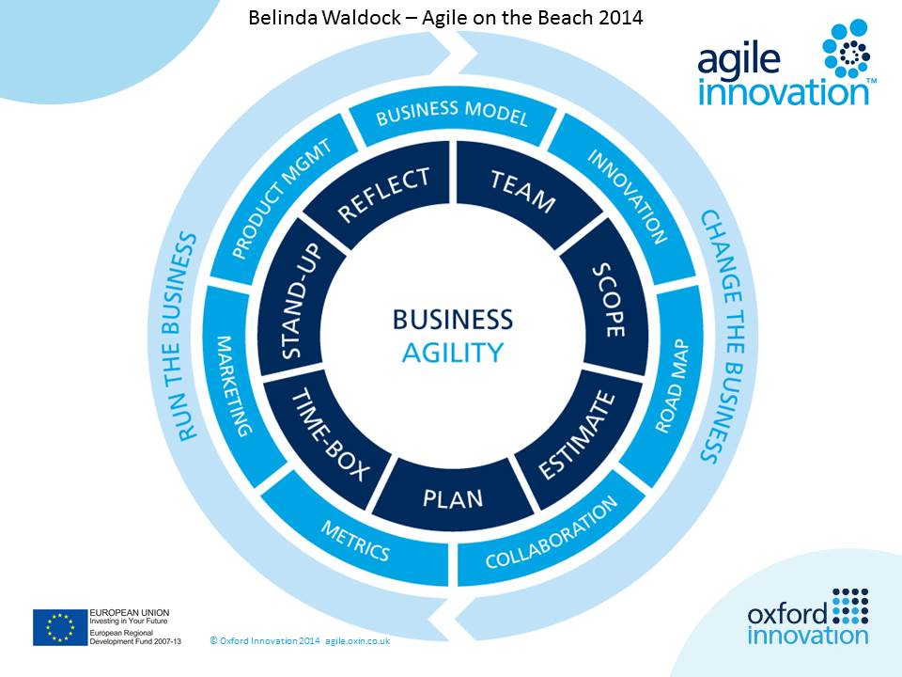
Business/Industry Needs
Agile for Model-Based-Standards Development
Business Scenarios
Business Consequences
Today, organizations are more aware of the importance of the digital integration and exchange of information assets.
Hence, information standards are developed to ensure an optimal interoperability and compatibility between information assets in order to exploit and process these assets in a consistent fashion.
Information requirements are not represented in the standard (i.e. gaps).
Time to reduce gaps (standards development) is not keeping with the speed of business need.
Interim interoperability cause non-value added costs to the business to:
OEM Submission of Technical Data Package to Authority for Certification
Manufacturing and Support Enablement
Design Integration
Manual re-entry and remodeling
Conversion cleanup
Cost of maintaining multiple CAD licenses
Supplier assertion costs

Slide 4
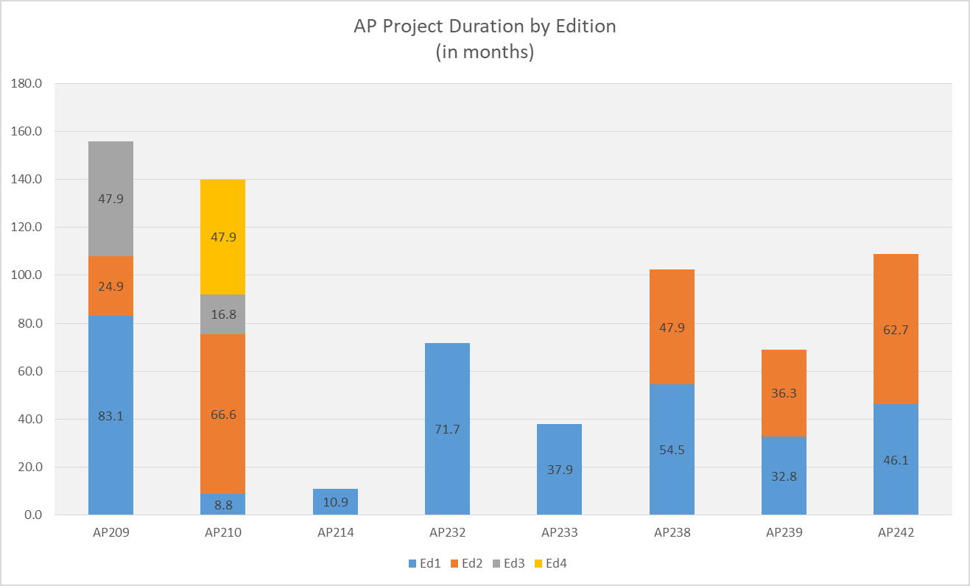
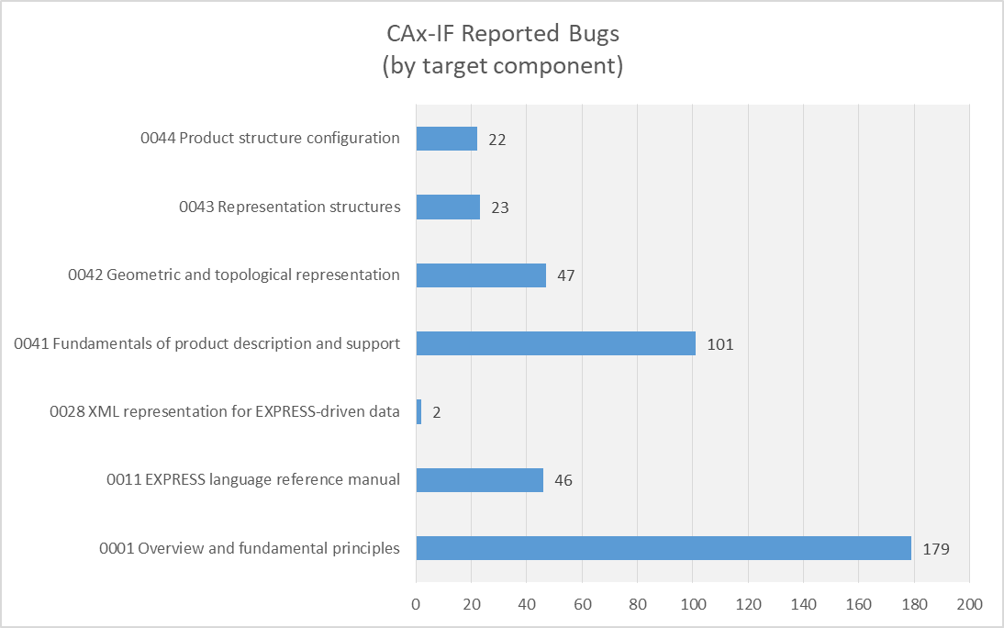
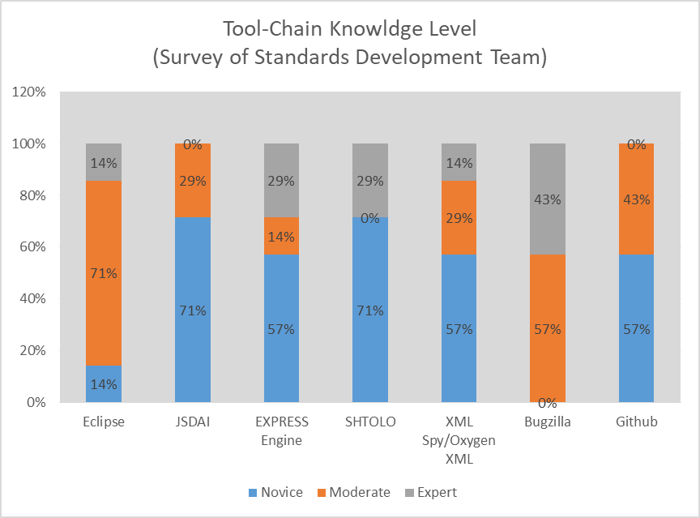
Problem Statement
Agile for Model-Based-Standards Development
Extended Development Time Length
Defects in Quality/Completeness of Releases
Failure to Gain Consensus
Non Optimized Tool-Chain
Lack of Workflow Constraints
Resource Commitment/Management
Volunteer Staff
Lack of Resources
Virtually Distributed Team
Lack of Knowledge
Attrition
Disjointed/Incomplete Training
Lack of Adequate Tool-Chain
Manually Integrated (process controlled)
Outdated Tools
Tools Extended Past Intended Usage
Notes:
Extended Length
sample across 8 standards and 16 edition publishes revealed the
current average project duration is 43.5 months (stage 10.99 to stage 60.60)
growth of 4.5 months from ed1 to ed2
Quality
Data Quality Issues
Incomplete Solutions
Overtly Complex/Non Implementable Solutions

Slide 5
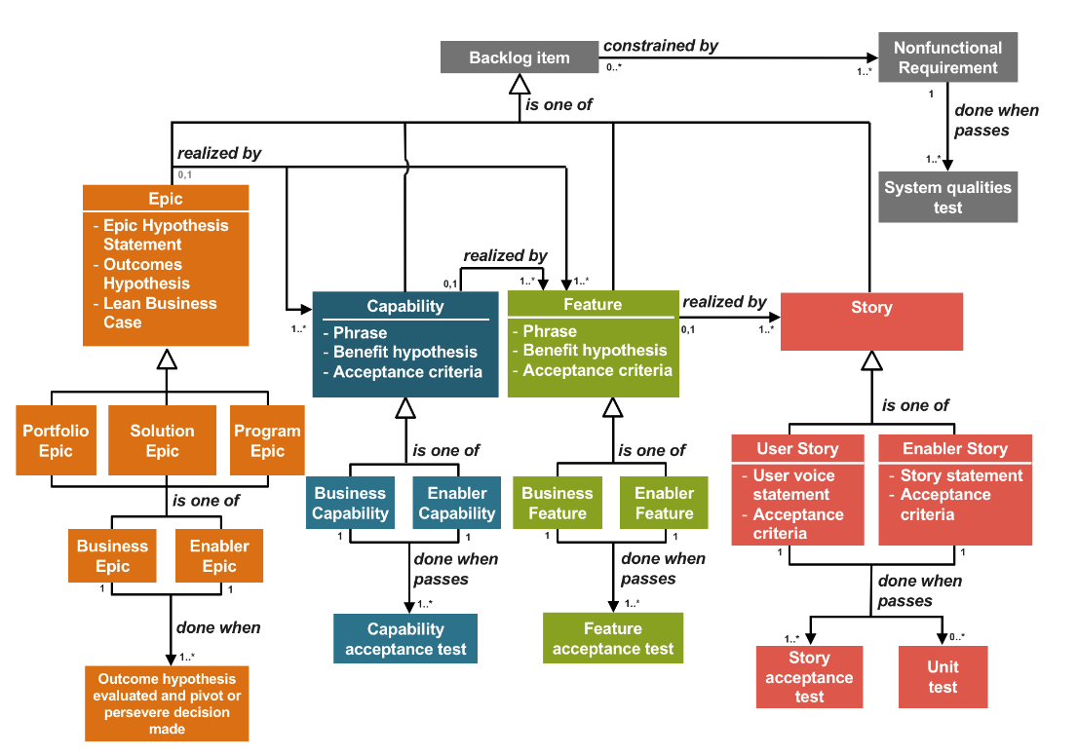
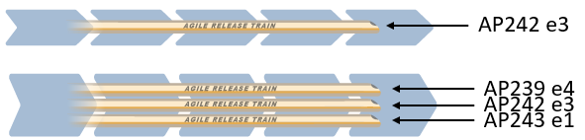
Proposed Solution 1: Backlog Management
Agile for Model-Based-Standards Development
Mel/Brandon

Slide 6




Proposed Solution 2: Agile Release Train
Agile for Model-Based-Standards Development
AP242e3
ART
PMI Team
Mel/Brandon
Define
Build
Test
Deploy
EWH Team
Agile Teams
Define
Build
Test
Deploy
AM Team
Scrum Master Product Owner Development Team

Slide 7
Proposed Solution 3: Program Increment Planning
Agile for Model-Based-Standards Development
ART
Mel/Brandon

Slide 8
Continued Research 1: Advanced Communication Tools
Agile for Model-Based-Standards Development
ART
Marion

Slide 9
Continued Research 2: Continuous Integration
Agile for Model-Based-Standards Development
ART
Marion/Sylvere

Slide 10
Benefits & Impacts
Agile for Model-Based-Standards Development
Benefits to MBS Developer
Benefits to Industry/Enterprise
Immediate feedback loop to detect and fix issues early
Increase transparency and visibility to other developers and team members
Avoid “integration hell”
Improve quality and testability
Increase speed of standards supporting info requirements gap closure
Reduction in interoperability costs (supplier assertion reduction, manual reentry, conversion)
Sylvere

Slide 11
Next Steps
Agile for Model-Based-Standards Development
Implement:
Backlog Management
JIRA or GIT KANBANs
Agile Release Train
JIRA Workflow Management
Program Increment Planning
JIRA Workflow Management
Planning Poker, T-Shirt Sizes, Dot Voting
Continued Research:
Advanced Communication Tools (for consensus management; requirements traceability)
Continuous Integration Tools & Automation (Bitbucket/Bamboo, Jenkins, AWS CodePipeline, and Gitlab)
EXPRESS Engine, JSDAI Compiles, Python scripts or ANT Builds

